Slide 1
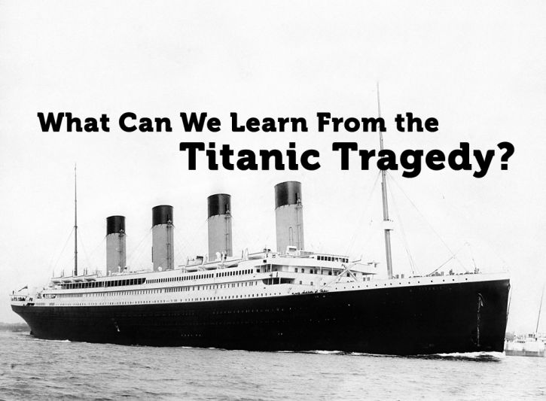
Assignment
Titanic sank after colliding with an iceberg, killing 1502 out of 2224 passengers and crew.
This tragedy led to better safety regulations for ships.
Main reasons of this disaster:
Lack of having enough lifeboats, and lifeboat drills for the passengers and crew.
Lack of training crew and passengers.
Fig 4. Titanic tragedy
Notes:
https://dc95wa4w5yhv.cloudfront.net/image-cache/what-can-we-learn-from-the-titanic-tragedy_725_533_80.jpg

Slide 2
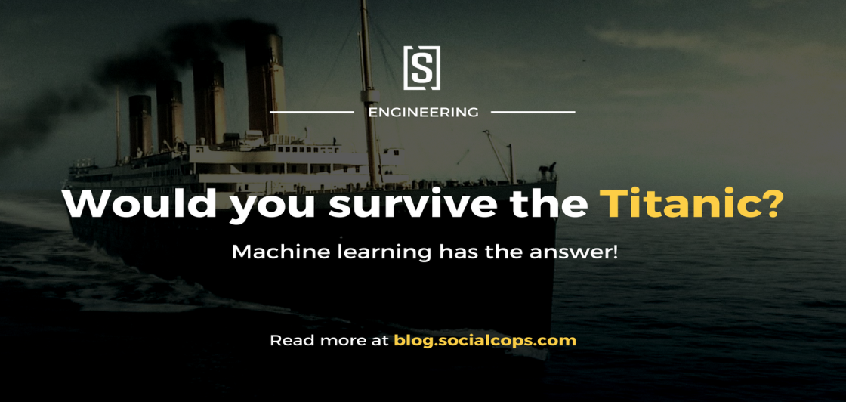
Assignment
Apply the tools of machine learning to predict which passengers survived the tragedy.
Write one page report about your developed model and interpret your result.
https://www.kaggle.com/c/titanic/data
Fig 5. ML and Titanic tragedy
Notes:
https://blog.socialcops.com/wp-content/uploads/2016/07/OG-MachineLearning-Python-Titanic-Kaggle.png

Slide 3
Steps for the Titanic Project
Import important libraries like pandas
Load the data
Visualize the data through Matplotlib library
Find the columns which contains missing values in both training and testing data sets
Clean the data by filling the missing values with median
Create a new columns by combining two columns to get more meaningful features and prevent noisy data if it is needed

Slide 4
Steps for the Titanic Project
Visualize the data with the new column if it is needed
Select just the important features( Feature selection)
Choose and build your machine learning model
Evaluate your model on the testing dataset( Find the accuracy of your model)
Interpret your result

